Slide 1
MagSails - Sep. 25 update
Magnetopause shape and standoff distances

Slide 2
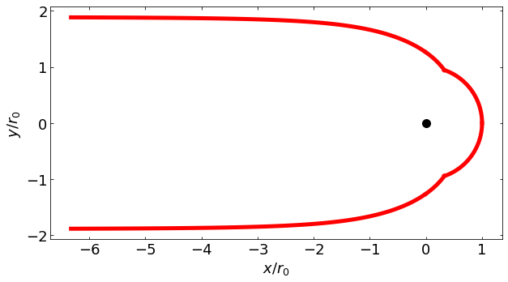
Analytical solution for a magnetopause created by dipole in a plasma flow (1960)

Slide 3
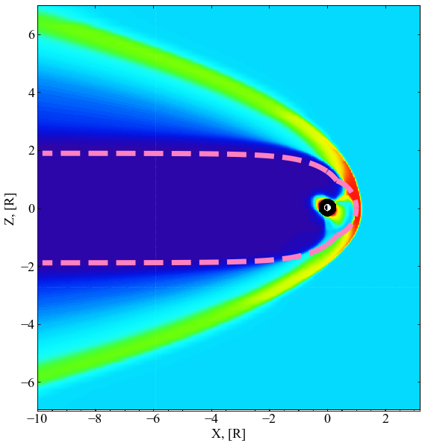
Comparison to Earth’s magnetosphere

Slide 4
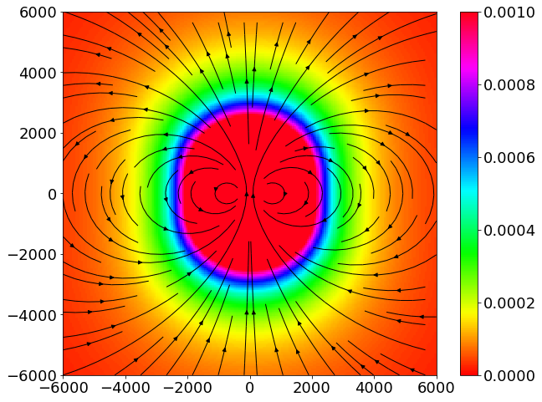
Pole-on
Equatorial
1m diameter magsail, 100 A

Slide 5
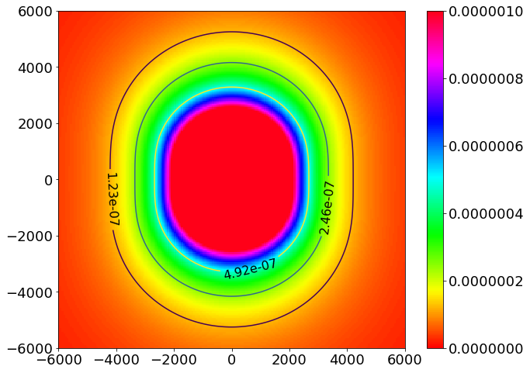
Standoff (polar)
Standoff (equatorial)

Slide 6
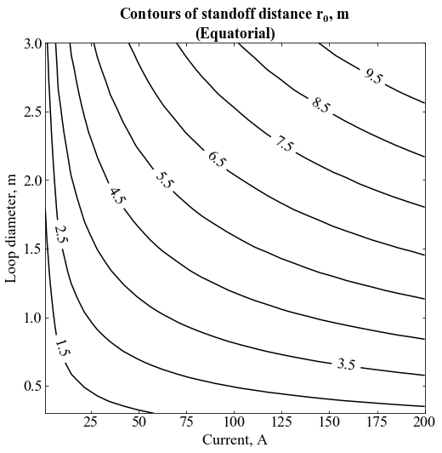

Slide 7
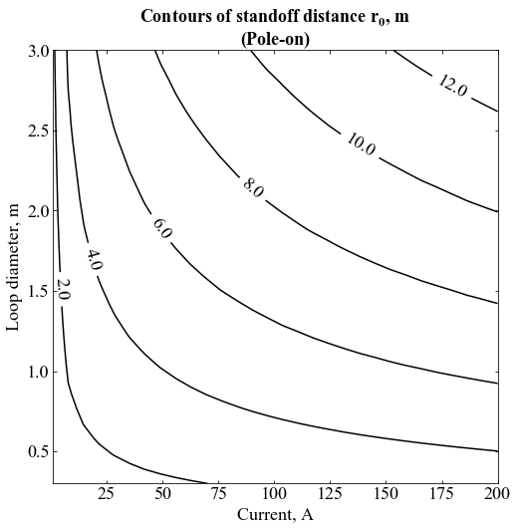

Slide 8
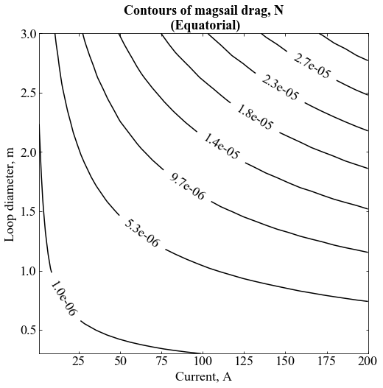

Slide 9
